Slide 1
Anticipation and change
The WHY? of anticipation
Prof. Dr. Mihai Nadin
www.nadin.ws

Slide 2
Anticipation and change
The WHY? of anticipation
Prof. Dr. Mihai Nadin
www.nadin.ws

Slide 3
1
Defining the knowledge domain
change
anticipation
A second Cartesian revolution
Complementarity at work
A program for action
2
3
4

Slide 4
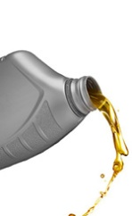
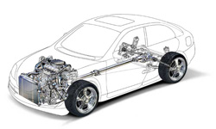
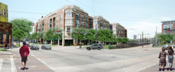
All there is … offspring of change
Time and space – consubstantial with change
Change conjures the future

Slide 5
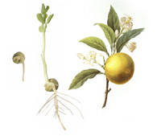
Change: outcome of interactions
Open-ended variety of changes
Open-ended variety of interactions
The dynamics of matter and the dynamics of living matter are different
Anticipation and life dynamics – from conception to birth, to death

Slide 6
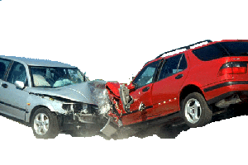
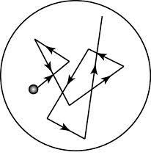
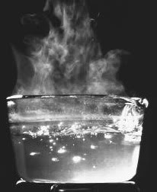
To know the world is to understand how it changes
periodic
accidental
infinitesimal
large
qualitative
Knowledge domains:
accounting for dynamics
describing change
attempting to know what change brings about

Slide 7
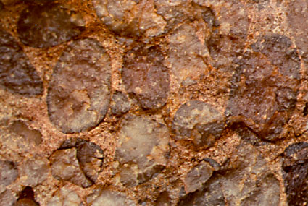
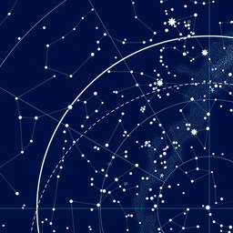
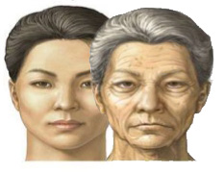
The nature of change reflects the condition of the existent
geology
oceanography
astronomy
botany
gerontology
politics
Ontological level—why changes
Epistemological level—how does everything change
Reaction: ontological entity characteristic of all matter.
The non-living: change expressed as outcome of reaction
Anticipation: ontological entity definitory of the living matter.
Change expressed as reaction and anticipation
implicit in living processes
autonomous function at all levels of life (from the molecular/cell to organisms and communities)

Slide 8
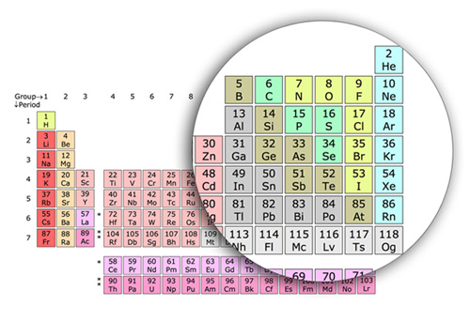
Matter
The non-living is what it is made up from:
The living: 4 molecules of life: proteins, carbohydrates, lipids and nucleic acids
96% of all molecules of life made up from carbon, hydrogen, oxygen, nitrogen, phosphorus and sulfur.
Essential minerals: iron, copper, manganese, zinc, chromium, selenium, lithium, cobalt, silicon, boron, etc.

Slide 9
Change in the living and non-living
Interaction in the physical: action-reaction
Change of the matter: physical and chemical processes
Change of position—forces at work defined through dynamics
The living is what it does: purposeful, adaptive, learning
The domain of anticipation-action
Physical and chemical change affected by living processes
The dynamics of the living: evolution

Slide 10
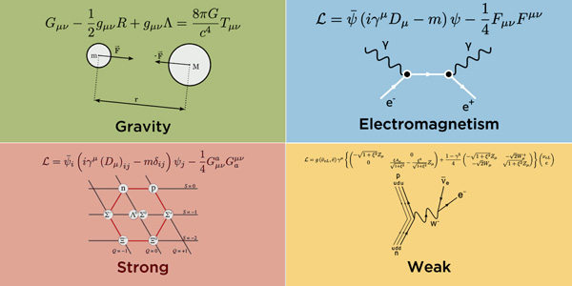
Physics: forces of change
force of the universe
force of planets and stars
force of atoms
force of life

Slide 11
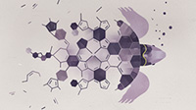
Descriptions of change
Dynamics described in terms of matter particles exchanging gauge bosons (gluons, W and Z bosons, photons)
Dynamics described in terms of machine functioning
Dynamics described in terms of chemical processes
Chemical interaction/processes:
Ionic forces
Hydrogen bonding
Dispersion forces
Van der Waals – dipole interactions

Slide 12
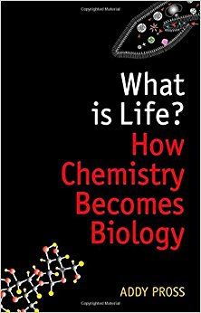
Reductionism
Life is physics: evolution as a collective phenomenon far from equilibrium
Nigel Goldenfeld, Carl Woese
Francis Crick, co-discoverer of DNA: "You, your joys and your sorrows, your memories and your ambitions, your sense of personal identity and free will, are in fact no more than the behaviour of a vast assembly of nerve cells and their associated molecules."

Slide 13
Reductionist contamination - examples
Physical forces in myelination and repair: a question of balance?
Nina G Bauer and Charles ffrench-Constant
J Biol. 2009; 8(8): 78. Sep 25, 2009
Physical forces during collective cell migration
Xavier Trepat, Michael R. Wasserman, Thomas E. Angelini, Emil Millet, David A. Weitz, James P. Butler & Jeffrey J. Fredberg
Nature Physics 5, 426 - 430; May 3 2009
Physical forces regulate plant development and morphogenesis
Arun Sampathkumar, An Yan, Pawel Krupinski, and Elliot M. Meyerowitz
Curr Biol. 24(10): R475–R483. May 19, 2014
Physical Forces between Humans and How Humans Attract and Repel Each Other Based on Their Social Interactions in an Online World
Stefan Thurner and Benedikt Fuchs; plos.org, July 21, 2015

Slide 14
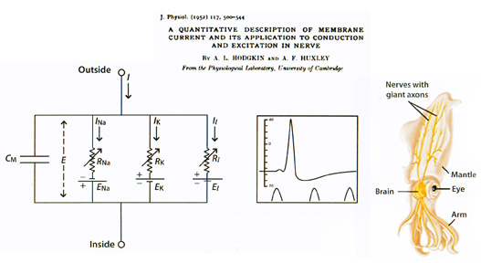
The limits of reductionism – a Nobel prize example
The physics of hearing will not explain anticipatory hearing

Slide 15
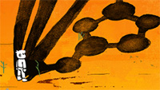
The make-up of the human being
It takes about 60 trillion atoms to make a human cell, 100 trillion cells to make a person, and 108 billion people have lived so far to build modern society.
Continuous cell renewal

Slide 16
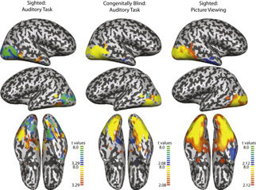
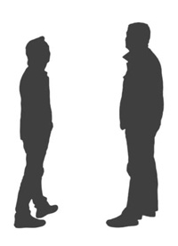
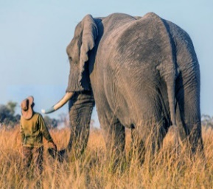
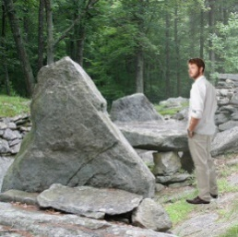
Perception of the non-living
Living – non-living interaction different from living – living
neural specialization
behavioral patterns at all levels of the living (plants, animals, insects, etc.)
Category-Specific Organization in the Human Brain Does Not Require Visual Experience, Mahon et al, Aug 13 2009

Slide 17
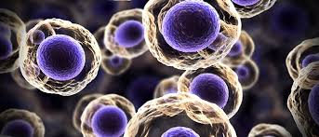
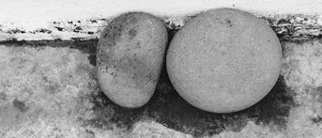
Distinctions – Empirical evidence
Anticipatory
Heterogenous
Purposeful
Non-deterministic
The Living
Reactive
Homogenous
Purpose-free
Deterministic
The non-living

Slide 18
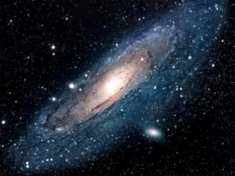
Nomothetic and idiographic
The non-living: change described through the laws of physics
Galileo
Newton
Einstein
Schrödinger
The living: Evolution as the record of change at the species level
Life and death
Reproduction
Goal oriented
Awareness

Slide 19
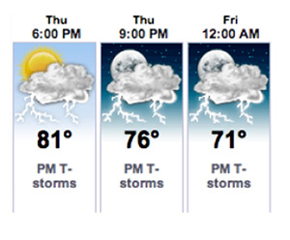
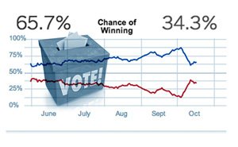
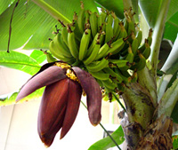
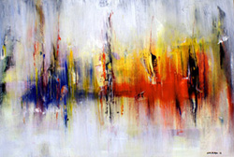
Distinctions
The future state of a physical (non-living) system can be described
in laws
predictions
forecasts
The future state of a living system can be subject to:
anticipation action within the system (autonomic function)
expectation
guessing
intuition
foresight
insight

Slide 20
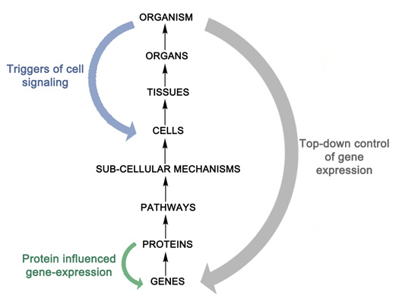
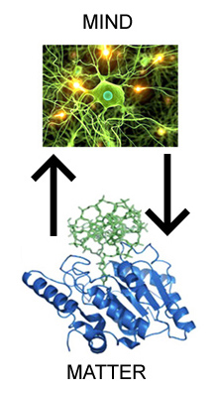
Mind over matter
The dynamics of the living is not reducible to that of the physics of forces, state of machines, chemical reactions
Change of/in the living subsumes change of its physico-chemical substratum

Slide 21
Change – interface to future
non-living to know is to predict, capture dynamics in form of law
living to know is to understand how change affects life
Knowledge of anticipation expressed in
empirical observation: record of behavior
understanding of the holistic nature of change
awareness of interactions

Slide 22
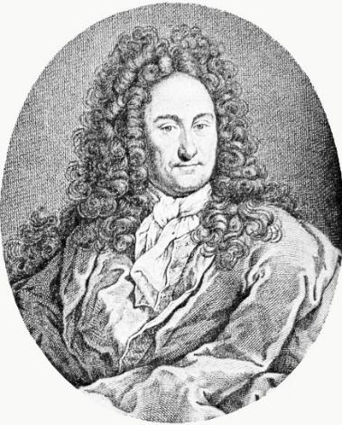
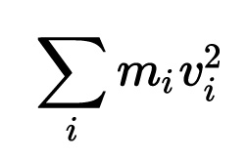
Anticipation is definitory of life
Preservation of life—analogous to the physical law of preservation of energy
Vis viva—living force—defined by Leibniz as the conservation of kinetic energy principle
The living: adaptive embodied matter changing as a result of interactions (endogenous and exogenous)
Preservation of life—endogenous processes (metabolism and self-repair), exogenous (adaptivity)

Slide 23
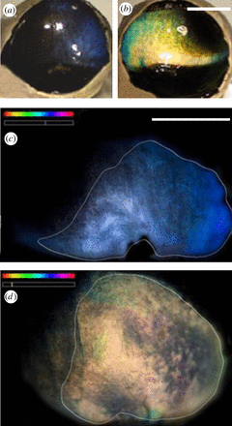
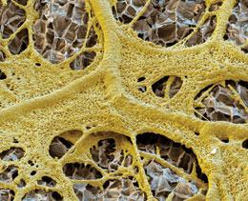
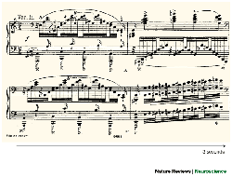
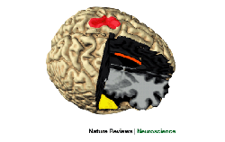
Examples of anticipation
Cellular memory hints at the origins of intelligence
Philip Ball; Nature 451, 385; January 23, 2008.
The musician's brain as a model of neuroplasticity
Thomas F. Münte, Eckart Altenmüller & Lutz Jäncke; Nature Reviews Neuroscience 3, 473-478; June 2002.
Deep cortical layers are activated directly by thalamus
Christine M. Constantinople and Randy M. Bruno; Science. 340(6140):1591-4; June 28, 2013.
Shifting mirrors: adaptive changes in retinal reflections to winter darkness in Arctic reindeer. Karl-Arne Stokkan et al; Royal Society Publishing; October 30, 2013.
Anticipatory brain activity predicts the success or failure of subsequent emotion regulation. Bryan T. Denny et al; Soc Cogn Affect Neurosci. 9(4):403-11. April 2014.

Slide 24
Taking in the world
Each observation (casual, intentional, measurement, etc.) changes the observer and the observed world
The recursive nature of observation

Slide 25
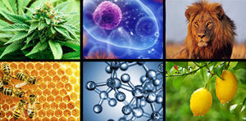
Characteristics of anticipatory processes
Life is maintained or ended through interaction
Action for preserving life
Expression of the whole
The living is necessarily anticipatory at all its levels
molecular
cell
tissue
organ
organism
species
nature

Slide 26
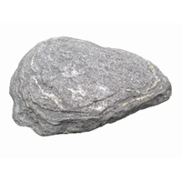
A system’s view of dynamics
Non-living: x(t) = ƒ(x(t-1), x(t))
current state previous state current state
Living: x(t) = ƒ(x(t-1), x(t), x(t+1))
current state past states possible future states
Current state is always MULTISTATE
The long tail of the living. The beginning of life is stamped on its present and future.
Giuseppe Longo: How Future Depends on Past and Rare Events in Systems of Life, Foundations of Science, 2017

Slide 27
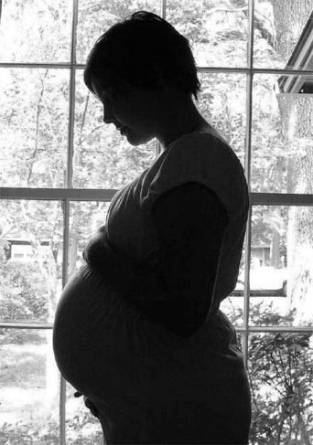
Life is the source of life
Interactions characteristic of the physico-chemical apply to all there is embodied in matter. They are subject to the principles of energy conservation.
Nature's way of protecting the embryo or fetus
Changed female body
Newton’s laws apply
Anticipatory behavior compensates for gravity
Elevated hormone levels including progesterone, oestrogen and human chorionic gonadotropin (HCG)
Long tail influences: (nausea associated with sense of balance)
nausea nausia ship

Slide 28
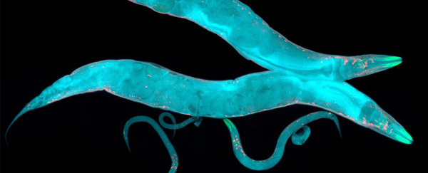
Epigenetic change
Scientists Have Observed Epigenetic Memories Being Passed Down for 14 Generations
The past lives on.
Signe Dean, April 21 2017
https://www.sciencealert.com/scientists-have-observed-epigenetic-memories-passed-down-for-14-generations

Slide 29
Significance
Domain of numbers/
description of quantities
Domain of meaning/
description of significance
In the living always both
quantity
meaning
Anticipation: the current state depends upon previous states, current state, meaning of possible future states
Prediction: does not cause change
Anticipation: factor of change

Slide 30
Determinism vs. non-determinism
Causality and anticipation
— deterministic — cause change
— non-deterministic — cause
Non-living: data well defined
Living: data ill defined; ambiguity
multitude of possible outcomes
immediate change
delayed change
no change

Slide 31
G-Complexity
Decidable: descriptions of change in physico-chemical
Undecidable: descriptions of change in the living
Complicated, Decideable
An object of knowledge inquiry is decidable if it can be fully and consistently described. Change above the G-complexity threshold is undecidable
Anticipation is couched in G-complexity
Newtonian physics - decidable
Dynamics of living - undecidable
Complex, Undecideable

Slide 32
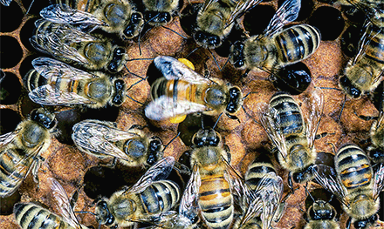
Adaptive behavior results from learning
Epigenetics and the evolution of instincts
Gene E. Robinson and Andrew B. Barron; Science. Vol. 356, Issue 6333, pp. 26-27. April 07, 2017.
Epigenetic processes based on learned beneficial behavior affect the DNA
DNA methylation, histone modifications, and noncoding RNAs as substratum for epigenetic induced changes
Plasticity precedes evolutionary adaptation
Honey bees instinctively know how to use movements and sounds to communicate to their hivemates about the location and quality of flower patches in the environment.
Bottlenose dolphins know how to swim

Slide 33
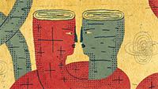
Success and self-delusion
Learned and instinctive components of behavior are intertwined
Adaptive sex allocation in anticipation of changes in offspring mating opportunities.
Placebo—anticipation at work—non-deterministic
Self-delusion: in all possible situations (superstition, religion, science, politics, art, etc.)—powerful anticipations

Slide 34
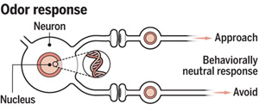
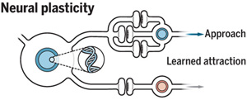
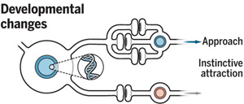
Example of a learned response
Epigenetics and the evolution of instincts
Gene E. Robinson and Andrew B. Barron
Science. Vol. 356, Issue 6333, pp. 26-27; Apr 07, 2017

Slide 35
Mind interaction
George Ellis: The mind is not a physical entity, but it is causally effective
analogy to hardware and software
All causes begin at the lowest levels of structure in the universe: electrons, protons, etc.
The hardware is “animated” by the software. Higher level logic controls the lower level electrical events.
the living: structured system—constrains the lower level interactions
Living interactions ---among cells and among all components of the individual—represent the top-down process; physical and chemical interactions—bottom up

Slide 36
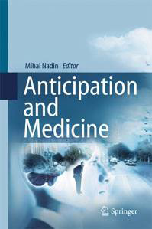
The WHY? question
The necessary anticipatory foundation of medicine
From reactive to proactive medicine
Individualized health care — a major social challenge
Immunotherapy
Genetic healing
Prevention
Anticipation and society
The less regulated a society, the higher the anticipatory expression
Regulation turns the living society into a machine with controls exercised through regulation.
From increased dependency to empowerment

Slide 37
The WHY? question

Slide 38
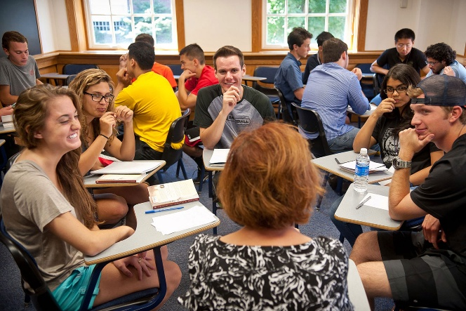
The WHY? question
Anticipation-based education
individualized
interactive
driven by shared questions
continuous in nature
proactive

Slide 39
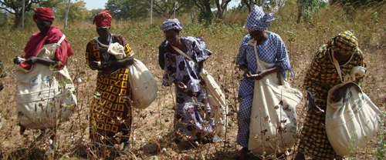
The WHY? question
Anticipation-driven social interaction
Observation:
Empower the individual and create circumstances for shared responsibility

Slide 40
The WHY? question
Sustainability – expression of anticipation
Morality is anticipatory
Holistic anticipatory expression corresponds to the top down dynamics
Effort and outcome—anticipation guiding the selection of means used

Slide 41
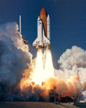
Metrics of success
Determinism:
Success of physics-grounded activities: industrial revolution, space exploration, new materials, nanotechnology
Reductionism:
Progress in specialized knowledge, the expert.
Machine reductionism:
The “mother of all machines” supporting every activity reducible to an algorithm
Sameness:
Sense of present
Metrics of anticipation-informed human activity:
Creativity, uniqueness, individual empowerment, sense of future
Difference:
Sense of future

Slide 42
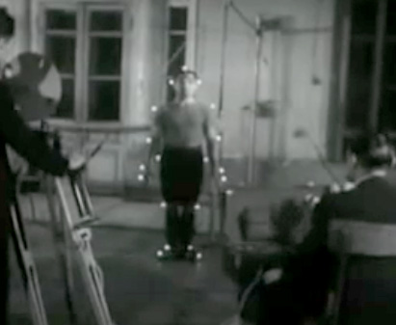
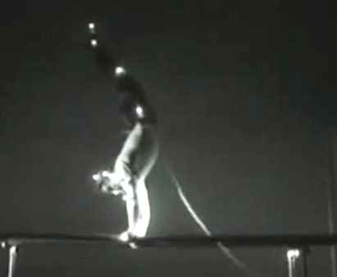
Metrics of failure
Anticipation awareness given up for the dominant knowledge model
Machine model takes over
Irreversible degeneration of the species
The survival of the species becomes questionable
Charles S. Peirce: the principle of variety is ‘the most obtrusive character of the universe’, which ‘no mechanism can account for’
N.A. Bernstein: Repetition without repetition

Slide 43
Credits
Nautilus. http://nautil.us/
Cell Press. http://www.cell.com/
ScienceAlert. http://www.sciencealert.com/
Science. http://science.sciencemag.org/

Slide 44
1
Change:
Physics
Chemistry
Other knowledge domains
Anticipation:
What makes it necessary
How it is acquired
How it is expressed
3
What is and what is not anticipation
4
Niels Bohr: complementarity
Example: light as particle/wave
Life: unity of reaction/anticipation
Practical consequences:
Study the nomothetic (pertinent to knowledge in physics, chemistry, etc. expressed through laws) and the idiographic (pertinent to knowledge of the living) in their unity
The holistic view
2
Descartes’ view of reality:
Determinism – an incomplete view of causality
Reductionism – effects on medicine, education, politics, other practical endeavors The machine view
Anticipation:
Causality in the living
Holism
“Repetition without repetition”
5
Medicine-- anticipation-based
Overcoming physics and chemistry based repair perspective
Integration of prevention and reactive health care
Genetic medicine
Immunotherapy
Engage the whole human being
Understand change in order to deal with aging

Slide 45
Or Y = {Y_{t}: t ∈ T},
Any countably infinite set can be indexed by the set of natural numbers
Example of narration:
Data associated with emotion
The meaning depends upon the context

